Slide 1
First Lego league
Techno TITANS
Core Values / Innovation Project / Robot Game

Slide 2
The Project and the Robot Game are what the students do.
FIRST Core Values are how they do it.

Slide 3
The FIRST Core Values
The Core Values are the heart of FIRST. By embracing the Core Values, participants learn that friendly competition and mutual gain are not separate goals, and that helping one another is the foundation of teamwork. We will be reviewing the FIRST Core Values with our team and discuss them whenever they are needed We will be expressing the FIRST philosophies of Gracious Professionalism and Cooperation through our Core Values:
Discovery: We explore new skills and ideas.
Innovation: We use creativity and persistence to solve problems.
Impact: We apply what we learn to improve our world.
Inclusion: We respect each other and embrace our differences.
Teamwork: We are stronger when we work together.
Fun: We enjoy and celebrate what we do!

Slide 4
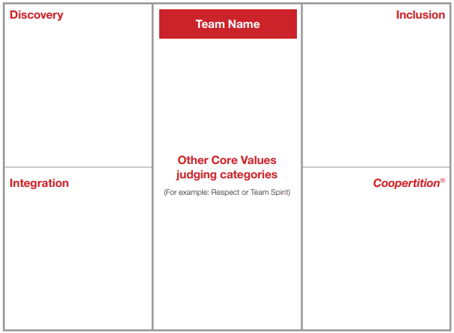
The core values poster
The Core Values poster is designed to help tell your team’s unique story. It may be a requirement at official events. We will be informed prior to any tournament whether or not a poster is required.
Core Values Video

Slide 5
The Project presentation
Any inventor must present their idea to people who can help them make it a reality, such as engineers, investors, or manufacturers. Like adult inventors, the Project presentation is your team’s chance to share their great Project work with the judges.
Your team’s presentation may include posters, slideshows, models, multimedia clips, props, costumes, and more. Creativity in the presentation is rewarded, but covering all the essential information is even more important.
Teams will only be eligible for Project awards if they:
Identify a problem that meets this year’s criteria.
Explain their innovative solution.
Describe how they shared with others prior to the tournament.
Presentation requirements:
All teams must present live. The team may use media equipment (if available) only to enhance the live presentation.
Include all team members. Each team member must participate in the Project judging session.
Set up and complete the presentation in five minutes or less with no adult help.
The teams who excel at tournaments also use the Project presentation to tell the judges about their sources of information, problem analysis, review of existing solutions, elements that make their idea innovative, and any plans or analysis related to implementation.

Slide 6
What is the Project video (1)

Slide 7
Project: Where to start video (2)

Slide 8
Present your project video (3)

Slide 9
The challenge: robot game
In the Robot Game, teams design, build, program and test autonomous robots using LEGO MINDSTORMS technology. The Robot Game playing field reflects the real-world theme for this season. Teams select which missions to solve in 2½ minute matches. Season-specific rules release with the Challenge.

