Slide 1
First Lego league
Techno TITANS
Gears / Medium Motor

Slide 2
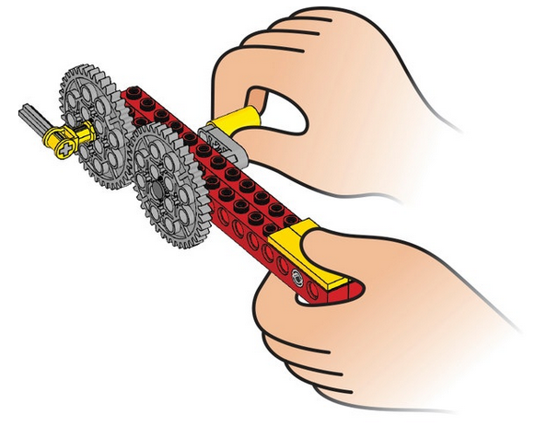
The drive gear is the gear that is turned by an outside effort, in this case your hand. Any gear that is turned by another gear is called the driven gear or follower.

Slide 3
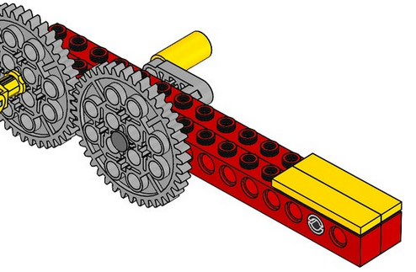
Try out the model and make observations.
Crank the handle one full turn, and count how many times the position marker turns. One turn of the handle results in one turn of the position marker (the gray axle). The speeds of rotation of the drive and the driven gears are the same, because they have the same number of teeth (40); this ratio is 1:1.
Observe which way the gears turn when you crank the handle, and draw arrows to show the directions they turn in. Adjacent gears turn in opposite directions.

Slide 4
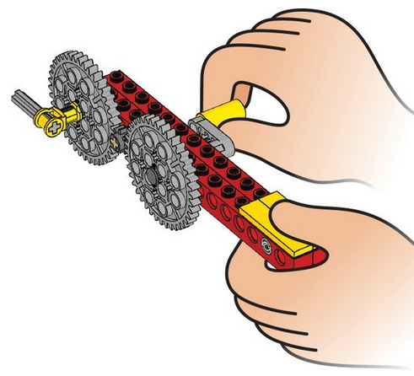
Idler gearing
The small gear is an idler gear. The idler gear does not affect the relative speeds of rotation of either of the larger gears, only the direction in which the driven gear turns.

Slide 5
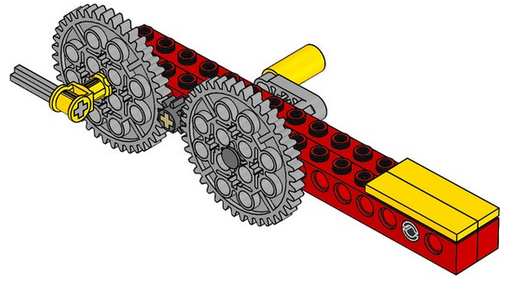
Crank the handle one full turn, and count how many times the position marker turns. One turn of the handle results in one turn of the gray axle. The speeds of rotation of the drive and the driven gears are the same, because they have the same number of teeth. The gearing ratio is 1:1.
Observe which way the gears turn when you crank the handle, and draw arrows to show the directions they turn in. The 40-tooth drive gear and the 40-tooth driven gear both turn in the same direction. The idler gear rotates in the opposite direction.

Slide 6
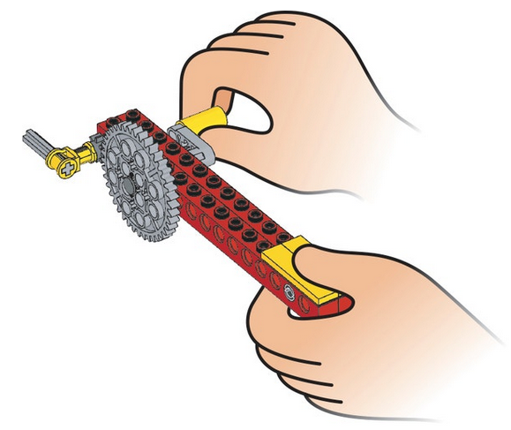
Increasing speed of rotation
Crank the handle one full turn, and count how many times the position marker turns. One turn of the handle (the large drive gear) results in five turns of the smaller driven gear. This ratio of 1:5 (or 1/5) is called the gearing up ratio (8/40 = 1/5). Increasing the gearing up ratio increases the speed of rotation of the driven gear, but decreases the force in the driven gear—the power of the gear to turn something.
Observe which way the gears turn when you crank the handle, and draw arrows to show the directions they turn in. Adjacent gears turn in opposite directions.

Slide 7
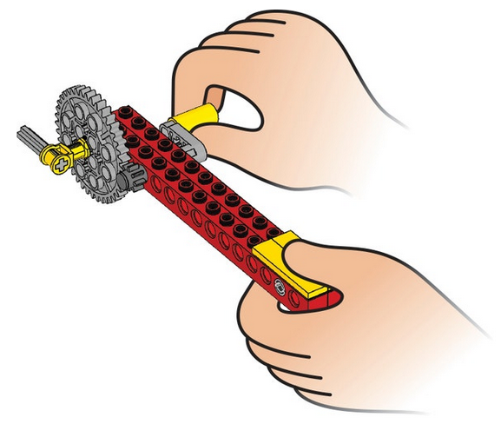
Decreasing speed of rotation
Count how many times the handle has to turn for the position marker to turn once. Five turns of the handle (the small drive gear) results in one turn of the large driven gear. This ratio of 5:1 (or 5/1) is called the gearing down ratio (40/8 = 5/1). Decreasing the gearing ratio decreases the speed of rotation of the driven gear, but increases the force in the driven gear—the power of the gear to turn something. Observe which way the gears turn when you crank the handle, and draw arrows to show the directions they turn in. *Adjacent gears turn in opposite directions.

Slide 8
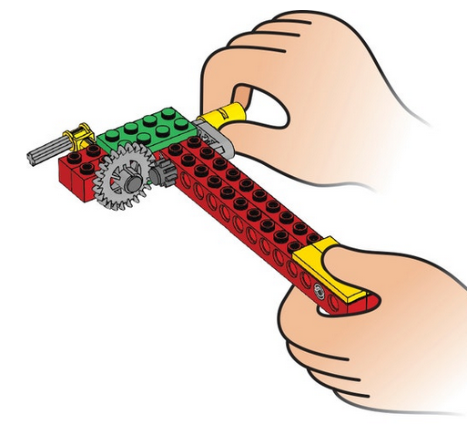
At an angle
The 8-tooth drive spur gear moves the 24-tooth driven crown gear.

Slide 9
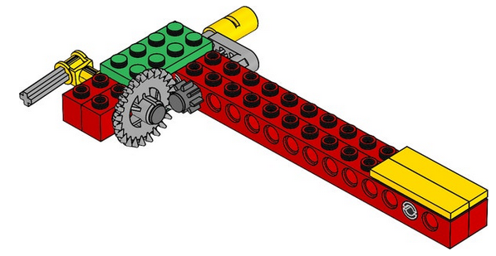
Count how many times the handle has to turn for the position marker to turn once. Three turns of the handle (the small drive gear) results in one turn of the crown gear. This is a ratio of 3:1 (or 24/8 or 3/1).
Observe which way the gears turn when you crank the handle, and draw arrows to show the directions they turn in.
The rotary motion is changed through a 90-degree angle/turns through an angle/turns a corner (the answer your students give will depend on their familiarity with describing angles). The crown gear can change the rotary motion easily because it has special curved teeth that enable it to mesh at an angle/at right angles in a different direction with a spur gear.

Slide 10
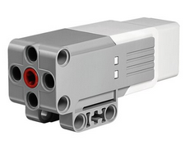
LEGO MINDSTORMS Education EV3 Medium Servo Motor
The EV3 Medium Servo Motor is great for lower-load, higher-speed applications and when faster response times and a smaller profile are needed in the robot’s design. The motor uses tacho feedback for precise control within one degree of accuracy and has a built-in rotation sensor.

Slide 11
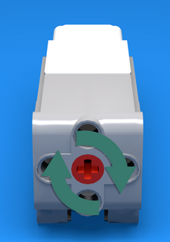
Typical use of the medium motor block
This motor is more precise, than powerful. You will have a hard time lifting heavy objects with a medium motor.
On the other hand, it is the most precise motor that can turn to one degree of precision and has very small lashback (the play between adjacent gears in the motor itself).
You will rarely have to program the motor outside the range of +180 to -180 degrees and most often you will need +90 or -90 degrees.

