Slide 1
First Lego league
Techno TITANS
Robot Design

Slide 2
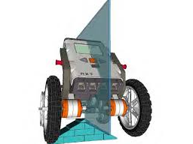
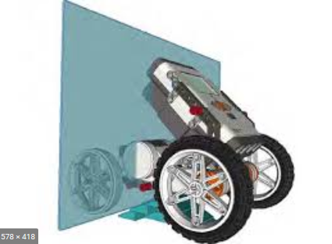
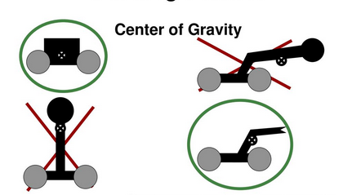
Robot Design : Size, Speed & Power
Size, too BIG takes away speed.
Too small and you can lose power.
The proper center of gravity will make your robot more stable.
Having the weight balanced between the wheels
Not too tall ensures the correct center of gravity.

Slide 3
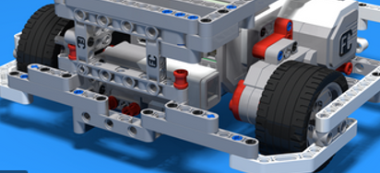
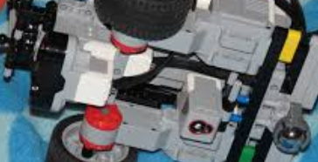
Robot Design : Chassis
Wheelbase needs to be wide enough to provide stability and be well supported for consistent results.
The sensors and motors you plan on using need to be built into the chassis design.

Slide 4
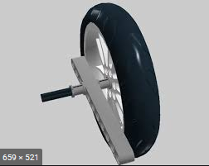
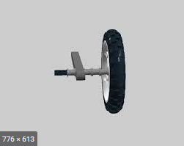
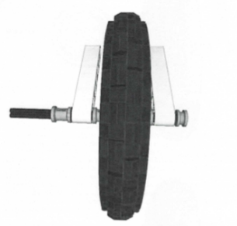
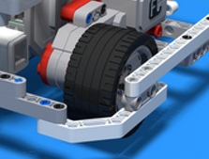
Robot Design : Wheels
Each bushing added to the wheelbase increases friction. More bushings will increase friction and will affect size, speed and power.
The best design is to have the axle and wheel supported evenly on both sides. This reduces friction and increase drive stability.

Slide 5
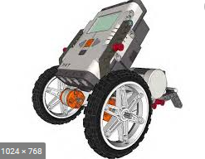
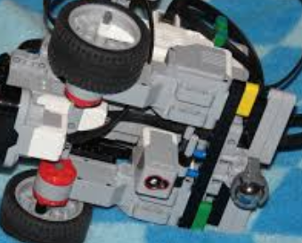
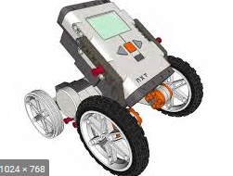
Robot Design : Wheels
How many? 2, 3 or 4
More wheels, the greater the stability.
More wheels can add weight and increases friction.
The number of wheels can affect the size, speed and power.
2 wheels with a skid.
3 wheels with ball caster.
4 wheels.

