Slide 1
First Lego league
Techno TITANS
Attachments

Slide 2
Attachments : types
Passive Attachment : These are attachments that do not require a motor to operate.
Pushing attachment
Hooking attachment
Dumping attachment
Collecting attachment
Spring-loaded attachment
Powered Attachment : These are attachments that enabled by a motor to operate.
Grabbing attachment
Lifting attachment

Slide 3
Attachments : Tips
Consistency – attachment should behave the same every single time.
Compact – attachment should compact and should not touch the mat.
Merge – merge attachments if possible, reducing the number of attachments.
Life is short – don’t get hung up on one mission. It okay to drop a bad idea.
All the same – try to make attachments that attach to the robot the same way.
Gravity – gravity is free, use it. Don’t use a motor if you can use gravity.
K.I.S.S – Keep It Simple Silly. Less moving parts = less to maintain or break.

Slide 4
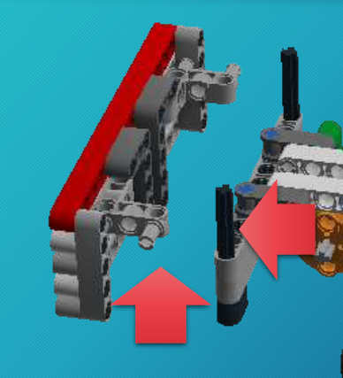
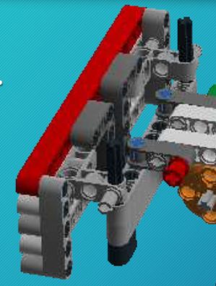
Attachments : Drop-on
Drop-on attachment typically use axles and gravity to mount to the chassis.
Quick to change.
Multiple attachments can mount to the same bracket.

Slide 5
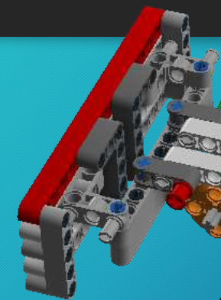
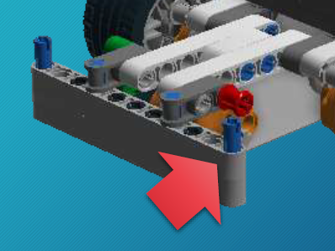
Attachments : mounted
Mounted attachment typically use pegs and/or other Lego® pieces to mount to the chassis.
Not as easily changed.
Best when structural strength is required.

